Slide 1


CSS453 Project-Cyber Crimes and Digital Forensics
Asst. Prof. Dr.Somchart Fugkeaw
PHISHING DETECTION TOOL USING
MACHINE LEARNING

Slide 2


Project Overview
Phishing is a prevalent cyber threat where attackers use deceptive communication to steal sensitive information. The increasing sophistication of phishing attacks necessitates robust and scalable detection mechanisms.
Our project focuses on developing a Phishing Detection Tool leveraging machine learning to combat phishing attacks in real-time and reliable mechanism.

Slide 3
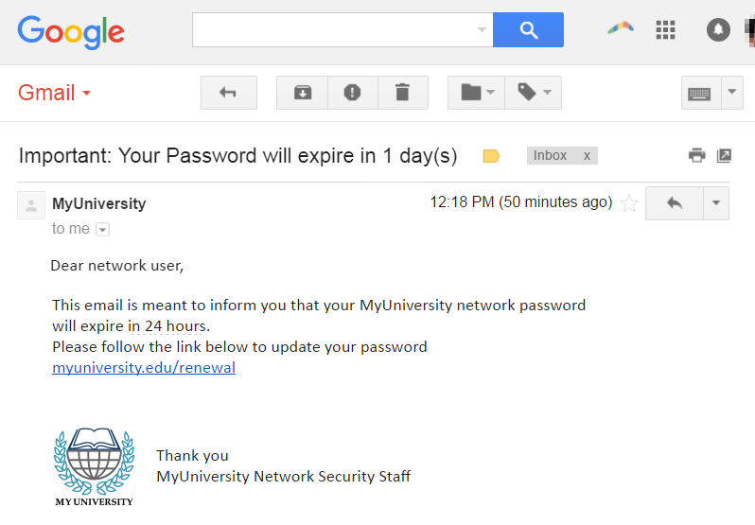

Slide 4
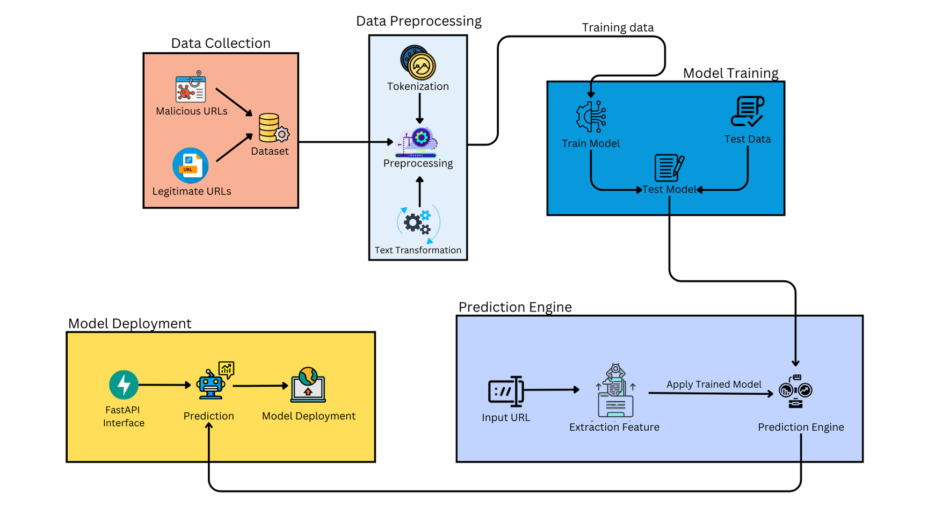
The system employs a structured pipeline consisting of five key phases:
1.Data Collection
2.Data Preprocessing
3.Model Training
4.Prediction Engine
5.Model Deployment

Slide 5
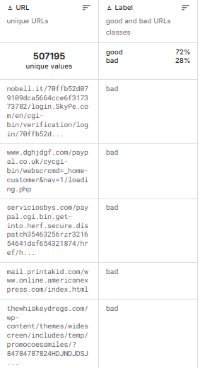
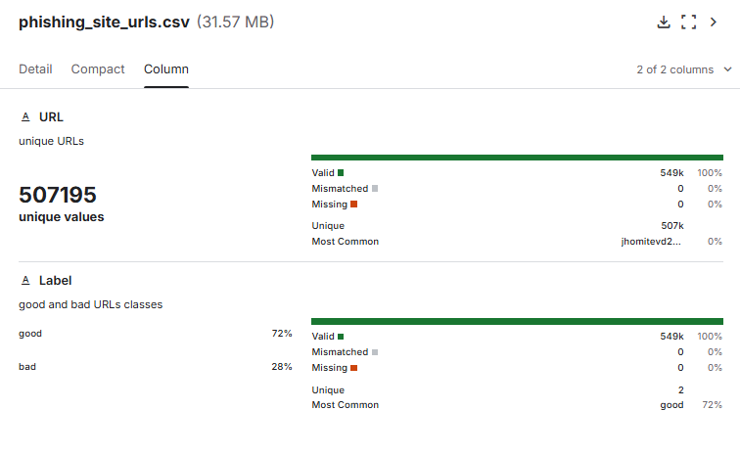
Data Collection
Example of Data
The system gathers a labeled dataset of legitimate and malicious URLs from trusted sources, including the phishing_site_urls dataset from Kaggle. This ensures a comprehensive and diverse foundation for model development.

Slide 6
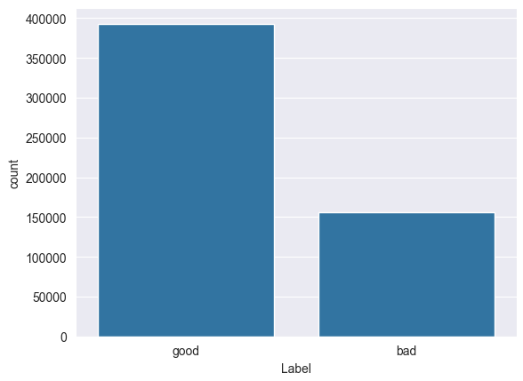
URL count
Total: 507,195 records

Slide 7

2. Data Preprocessing
Raw URLs are transformed into structured formats through tokenization, feature extraction, and vectorization techniques
This phase removes irrelevant information and standardizes the dataset for effective training.

Slide 8

Important and Useful Python Library
NLTK (Natural Language Toolkit)
RegexpTokenizer
-> used for tokenizing text using regular expressions (regex).
urls = ["http://example.com/free-money!!!"]
tokenizer = RegexpTokenizer(r'[a-zA-Z0-9]+(?:\.[a-zA-Z0-9]+)*|https?://|/|\?|=|%20|!+')
Tokens: ['http://', 'example', 'com', '/', 'free', 'money', '!!!']

Slide 9
Important and Useful Python Library
NLTK (Natural Language Toolkit)
Snowball Stemmer
-> used for stemming( the process of reducing words to their root or base form)
urls = [https://phishing-alert.com/win-free-money-now]
Tokens: ['phishing', 'alert', 'com', 'win', 'free', 'money', 'now']
Stemmed Tokens: ['phish' , 'alert' , 'com' , 'win' , 'free' , 'money' , 'now']

Slide 10
Important and Useful Python Library
Web driver and Web Scraping
Edgedriver
-> WebDriver implementation for Microsoft Edge
BeautifulSoup
-> parsing and extracting data from HTML and XML files

Slide 11
3. Model Training
Supervised machine learning algorithms, such as Logistic Regression and Multinomial Naive Bayes, are employed to discern phishing patterns. The models are evaluated using performance metrics, including accuracy, precision, recall, and F1-score, ensuring robustness and reliability.
The model used for training in this project
1.Logistic Regression
2.Multinomial Naive Bayes

Slide 12
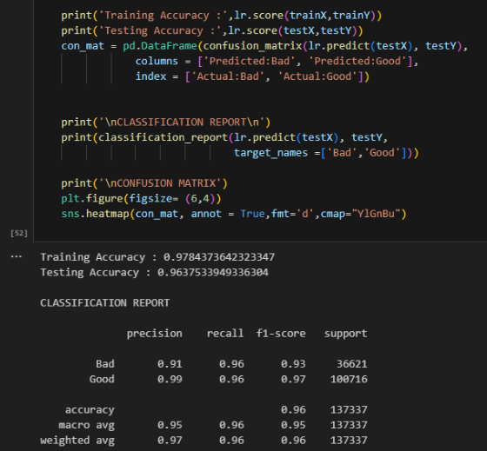
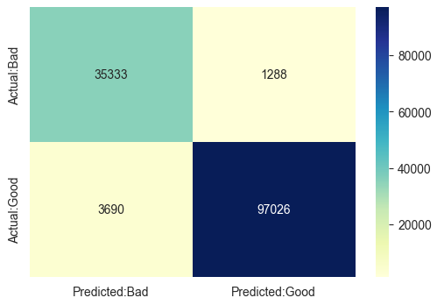
Logistic Regression
This image shows the performance evaluation of a Logistic Regression model, achieving a training accuracy of 97.84%, testing accuracy of 96.37%
The matrix confirms the effectiveness of the Logistic Regression model for phishing detection tasks.
It correctly identified 35,333 bad URLs and 97,026 good URLs, but it made some mistakes: it wrongly marked 1,288 bad URLs as good and 3,690 good URLs as bad.

Slide 13
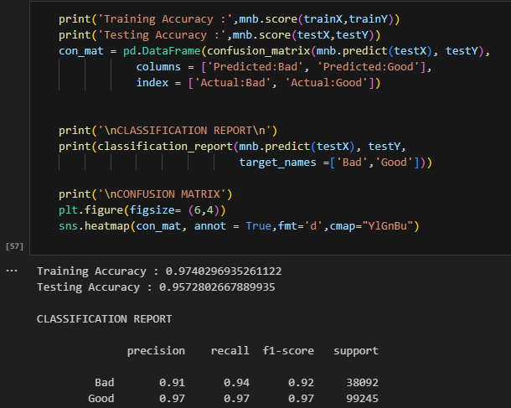
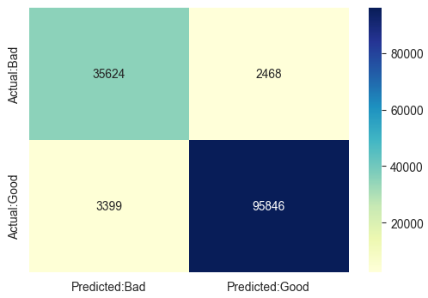
Multinomial Naive Bayes
This image shows the performance of a Multinomial Naive Bayes model. It achieved a training accuracy
of 97.42% and testing accuracy of 95.73%
This confusion matrix shows the Multinomial Naive Bayes model identifies phishing (bad) and legitimate (good) URLs.
It correctly classified 35,624 bad URLs and 95,846 good URLs. However, it made 2,468 mistakes by marking bad URLs as good and 3,399 mistakes by marking good URLs as bad .

Slide 14
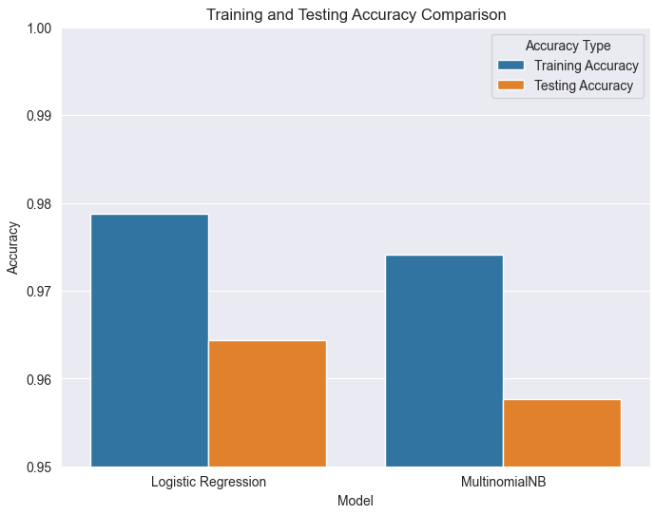
Comparison of 2 Model
This bar chart compares the training and testing accuracy of Logistic Regression and
Multinomial Naive Bayes, showing that Logistic Regression achieves higher accuracy,
making it the better-performing model for phishing detection in this project.

Slide 15
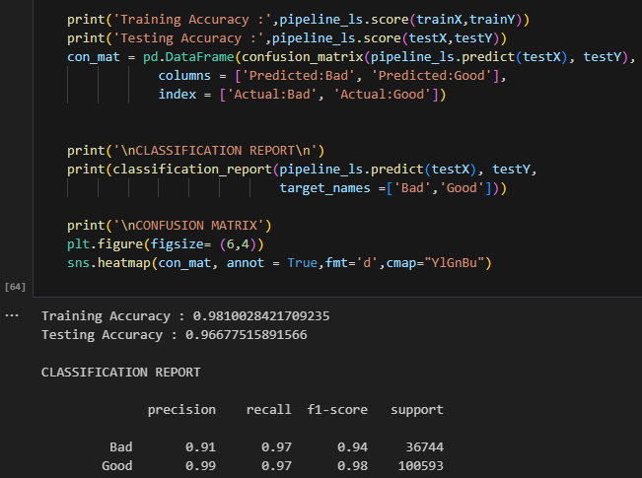
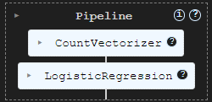
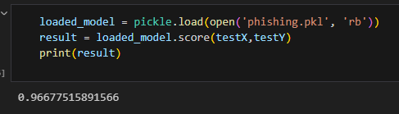
Logistic Regression using sklearn pipeline for vectorization technique
This result demonstrates the performance of the Logistic Regression model implemented via a scikit-learn pipeline, achieving a training accuracy of 98.10% and a testing accuracy of 96.68%
Final Accuracy: 96.67%

Slide 16

4. Prediction Engine
This core component processes new URLs in real time, classifying them as legitimate or malicious based on patterns learned during training. Additional insights, such as confidence scores, are provided for enhanced decision-making.

Slide 17


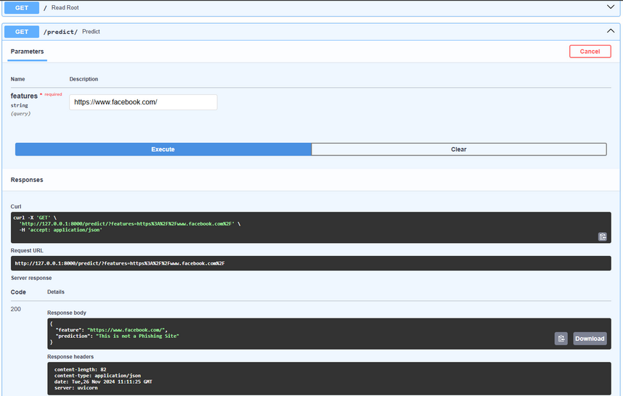
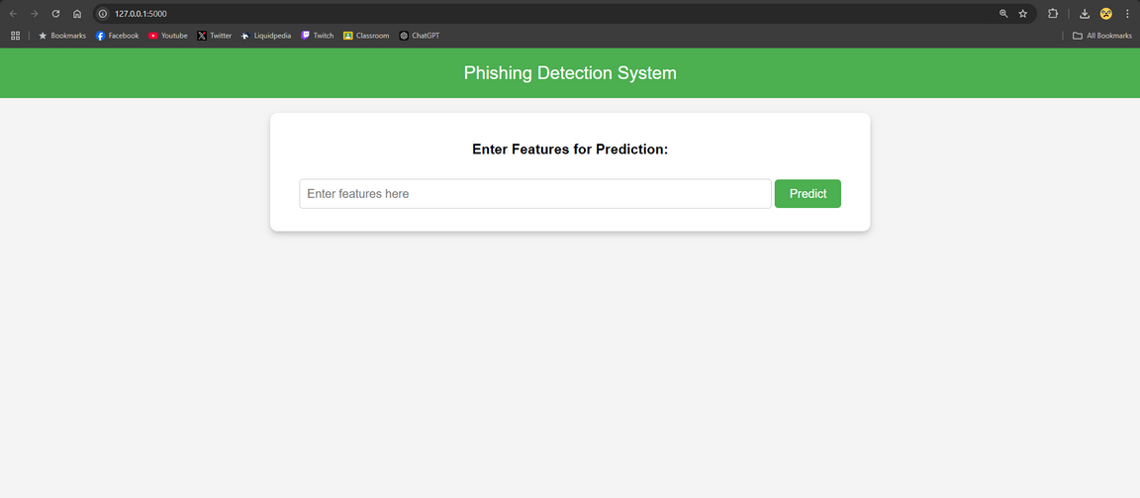
5. Model Deployment
A FastAPI interface enables seamless integration into real-world applications, such as email services, web browsers, or organizational networks. The system is optimized for scalability, handling multiple prediction requests simultaneously.
ใส่รูป
ใส่รูป

Slide 18

DEMO

Slide 19
Contribution
Supawit Nakprame 6422770287, Report, Presentation, Methodology, Evaluation
Surabordin Sungchai 6422782514, Report, Model Visualization, Reference
Panpatchara Naneplai 6422782522, Report, Presentation, Methodology, Software Testing
Anakin Palinyot 6422782530, Report, ML Development, System Integration, Presentation, Methodology

Slide 20
Safeguarding Your Digital Assets
Thank You

